Slide 1

By Mac & Cheese:
Jethro Phuah
Lam Zhi Fah
Alicia Chua Jieying
Ernest Ang Cheng Han
Ong Jing Heng Shaun
Ong Sim Hao
Shannon Tan Xinyi

Slide 2
Table of Contents
1
2
Project Introduction
Design for Maintainability
3
Software Quality Assurance
4
Project Management
5
Risk Management

Slide 3
Project Introduction

Slide 4


Problems faced
Cabin Fever
No one-stop app to view all 3:
Places of interests
Events
Food locations
Notes:
Due to the pandemic and lack of opportunity to travel overseas, many are starting to feel extremely cooped up in this little red dot. They feel as though there is nothing to do and see. What they don’t know is that there are actually many hidden gems in Singapore. However, these gems can be difficult to find as there is no application which displays places of interests, events and food locations.

Slide 5
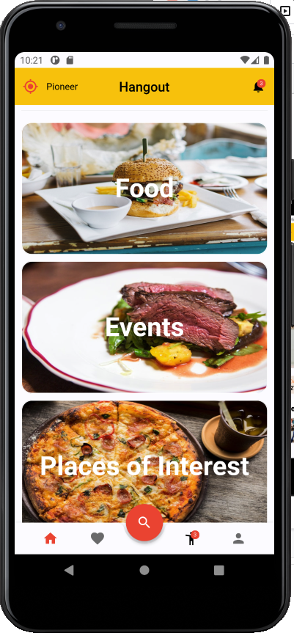
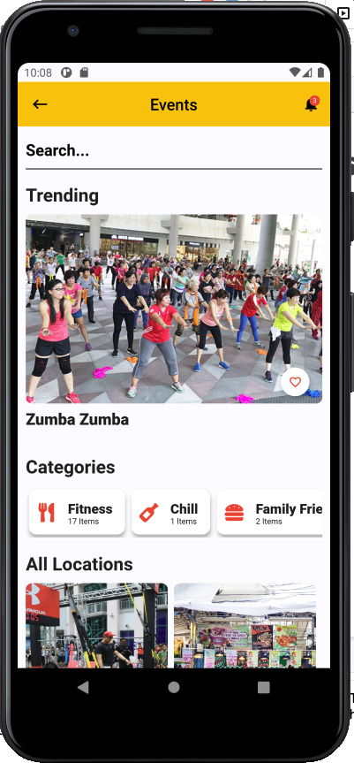
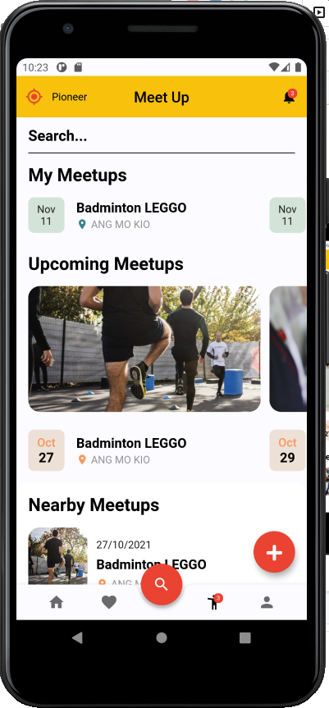
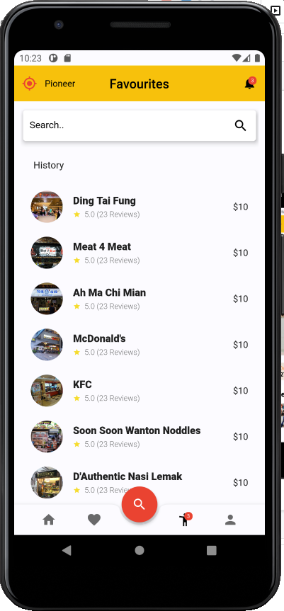
Our Solution - HangOut App
Notes:
Hence, we decided to create HangOut. HangOut is an application which allows users to have a bird’s eye view of what is happening in their neighbourhoods. Not only that, users can save their favourite locations and even initiate meetups. More of our app will be shown during the demo later.

Slide 6
Design for Maintainability

Slide 7
Early Planning
Perform analysis and predict the different kinds of improvements we would be implementing in the future after the release of the application
Usability: software must flow according to the user’s expectations, offer required information and provide navigation controls that are clear to understand.
Scalability: handle much higher traffic rates as the user base continuously expands
Notes:
During team meetings, the group will discuss the important features that should be included in the mobile application to enhance user experience. We would also perform analysis and predict the different kinds of improvements we would be implementing in the future after the release of the application. As such, we will be focusing on the Usability aspect of Hangout for the members of the public as we foresee a broad user base. The software must flow according to the user’s expectations, offer required information and provide navigation controls that are clear to understand.
When the widespread usage of the application becomes the norm, it will have to be scaled up to handle much higher traffic rates as the user base continuously expands. Hence, we also targeted Scalability as one of the factors that we have to look into in the future.

Slide 8
Design Strategy - Correction By Nature
Corrective Maintainability
Fault detection done through testing, followed by reactive modification of the software product to correct any discovered problems.
Preventive Maintainability
Features implemented in atomic manner, and each feature is tested independently. This allows for errors to be detected easily and respective modifications can be carried out before they become effective faults.
Notes:
For official testing of Hangout, we will be implementing the following procedures and this is what we will look out for:

Slide 9
Design Strategy - Enhancement By Nature
Adaptive Maintainability
Software can be easily adapted to a new operational environment without much issues.
Perfective Maintainability
After the application is up and running, we are able to quickly detect any errors and correct them when required, which helps reduce maintenance costs and time needed.
Notes:
We will enhance our application while testing the application and this is what we will look out for:

Slide 10
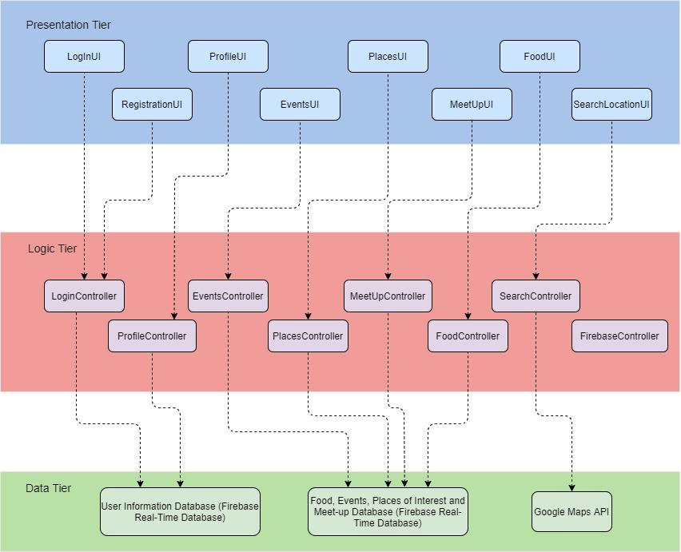
Architectural Design Pattern
Promotes Modularity
Each tier can be easily modified, updated or scaled without impacting the other functions.
Notes:
Since HangOut is heavily dependent on the user experience, we decided to adapt the 3-tier architectural model. This system infrastructure framework will be beneficial for Graphic User Interface design. It promotes modularity since each tier can run on its own infrastructure. This means that each tier can be easily modified, updated or scaled without impacting the other functions.

Slide 11
Maintainability Practices
To uphold quality in both process and product, we have implemented the following maintainability practices over the course of our project:
Readable Code
Version Control
Standardised Documentation
Modularity

Slide 12
Software Configuration Management Tools
Access Control
Traceability between software
and test ware and different versions
of the variant
Build and release management

Slide 13


Software Configuration Management Tools
Used as a file storage and sharing system
Version control is also available
Distributed version control and source code management
Chosen for its familiarity and support provided by various IDE applications

Slide 14


Software Configuration Management Tools
Wide range of functions which allows users to create their information in different styles.
Allows users to concurrently edit the page at the same time.
Revision and version control, enables us to track different versions of the source code files and documents being uploaded and edited.

Slide 15
Software Quality Assurance

Slide 16

Objectives
Establish the goals, processes, and responsibilities to ensure that HangOut complies with defined quality specifications and standards

Slide 17
Flow
Ensure Correct Processes
Development of products
Meet established requirements and standards
Stakeholder expectations
Notes:
SQA ensure that project conforms to processes which consistently lead to products that meet the established requirements that fulfills stakeholder wants needs and expectation

Slide 18


Activities
Quality Planning
Quality Control
Determine quality assurance standards, practices and metrics
Ensures that biases are avoided, and key issues are accurately addressed
Weekly meetings to inspect and review product
Report problems and perform corrective measures
Notes:
If any issues discovered, the team will follow a standard problem reporting procedure...

Slide 19



Reviews
Management Reviews
Technical Reviews
Audits
Proper allocation of roles & responsibilities
Monitor progress of tasks
Evaluation of performance
Conduct product and process assessments
Identify/report findings, observations, and risks from all software assurance related activities
Adhered to approved auditing procedures and tools
Anomalies detected are identified, documented, addressed, and tracked to closure
Notes:
Consistent reviews will be done on the the SQA plan to ensure that it is up to date with the current development phase
Performing regular audits ensures everyone are updated on the current SQA plan

Slide 20
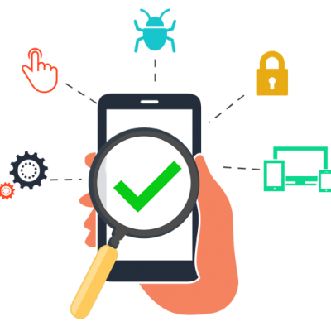

Testing
System Testing
User Acceptance Testing
Unit Testing
Integration Testing
Focuses on integrating the components and ensuring that data/information can flow smoothly
Fully exercise the software system and explore any possible limitations in the system
Actual intended users test the final product
Ensure that the software system is able to handle all the required use cases and perform required functions
Conducted at development phase of the project
Ensures that implementation errors are looked into, and isolates each individual unit of the code to verify their correctness
Notes:
As part of our Software Development Process, software testing will be carried out on the following levels
SQ personnel and manager will monitor testing efforts to assure that test schedules are adhered to and maintained to reflect an accurate progression of the testing activities

Slide 21
Achievements

Slide 22
Labs
Deliverables
Project Proposal, System Requirement Specification, Risk Management Plan, etc
Notes:
Lab 1 Deliverables (by week 4):
1. Project Proposal
2. Use case model
Lab 2 deliverables (by week 6):
1. System Requirement Specification
2. Quality plan
Lab 3 deliverables (by week 8):
1. Project Plan (Wiki)
2. Risk Management (Wiki)
3. Prototype ready for simple demo
4. SVN: Prototype related items such as code, documents, slides video clips
Lab 4 deliverables (by week 10):
1. Design Report on software maintainability (wiki)
2. Configuration Management Plan (wiki)
3. Change management plan (wiki)
4. Release plan (wiki)
Lab 5 deliverables (by week 12):
1. Presentation slides (wiki)
2. Test plan (wiki)
3. Test cases and requirement test coverage report(wiki)
4. CMMI level 2 definition (wiki)
5. SVN: Version control system

Slide 23
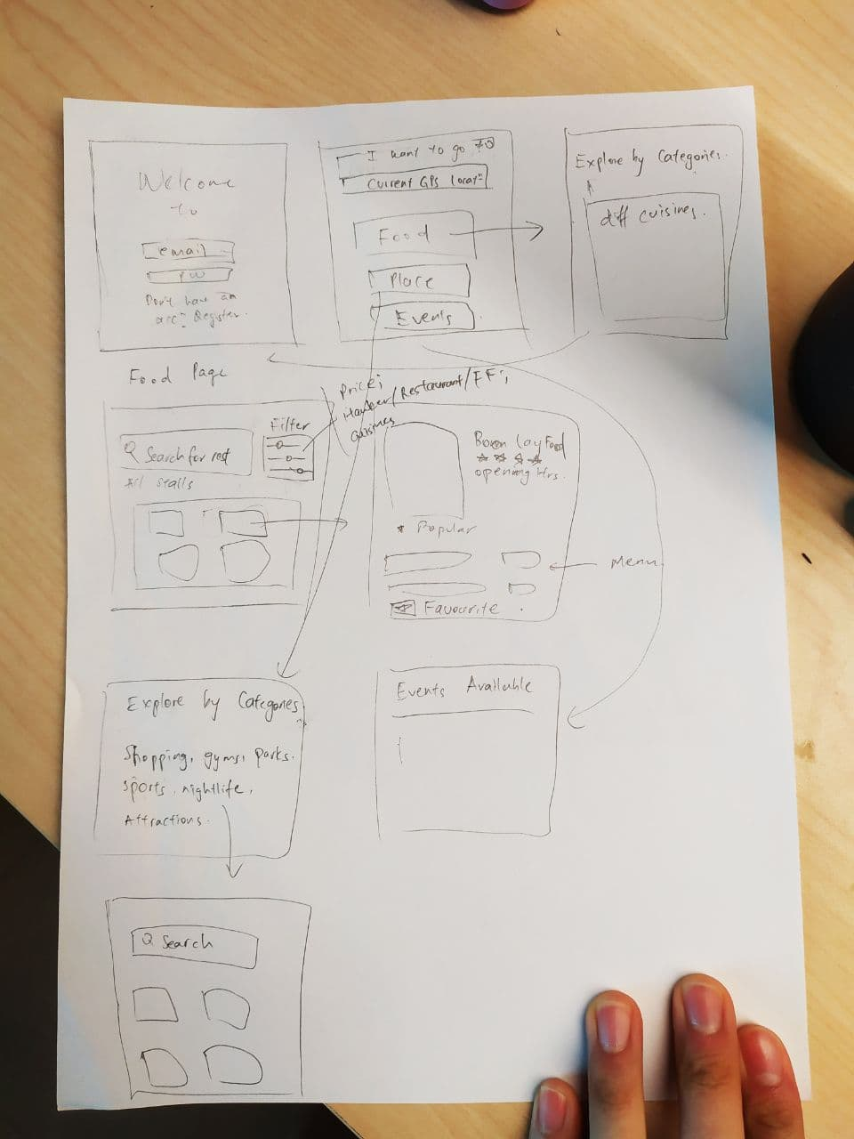
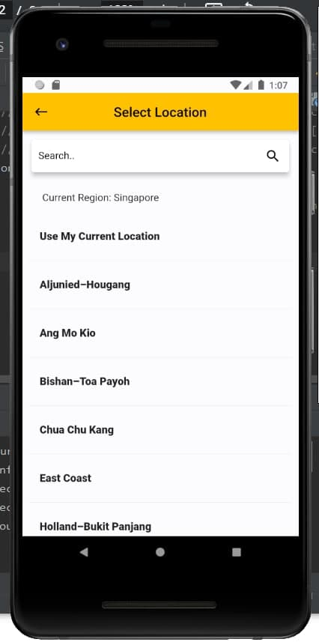
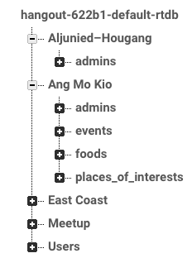
Evolution Of Our App
1
2
3
Lo-Fi Prototype
Hi-Fi Prototype
Link to Firebase database
Notes:
Lab 1 Deliverables (by week 4):
1. Project Proposal
2. Use case model
Lab 2 deliverables (by week 6):
1. System Requirement Specification
2. Quality plan
Lab 3 deliverables (by week 8):
1. Project Plan (Wiki)
2. Risk Management (Wiki)
3. Prototype ready for simple demo
4. SVN: Prototype related items such as code, documents, slides video clips
Lab 4 deliverables (by week 10):
1. Design Report on software maintainability (wiki)
2. Configuration Management Plan (wiki)
3. Change management plan (wiki)
4. Release plan (wiki)
Lab 5 deliverables (by week 12):
1. Presentation slides (wiki)
2. Test plan (wiki)
3. Test cases and requirement test coverage report(wiki)
4. CMMI level 2 definition (wiki)
5. SVN: Version control system

Slide 24
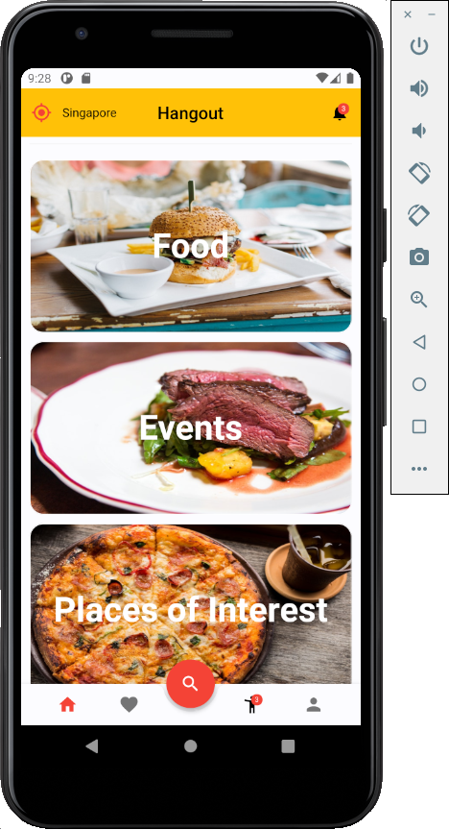
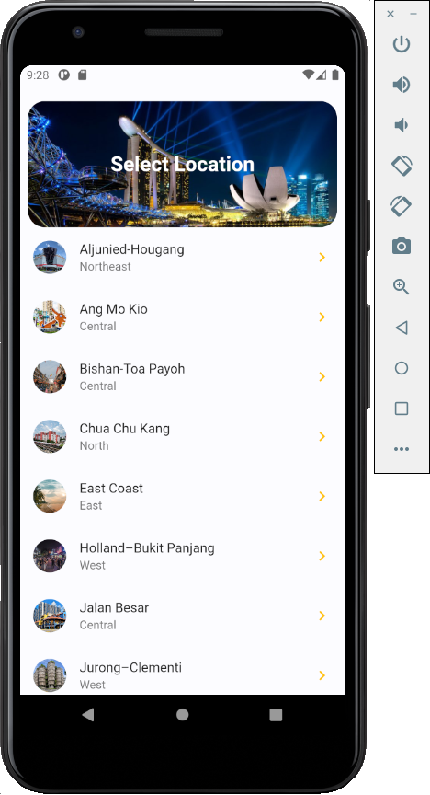
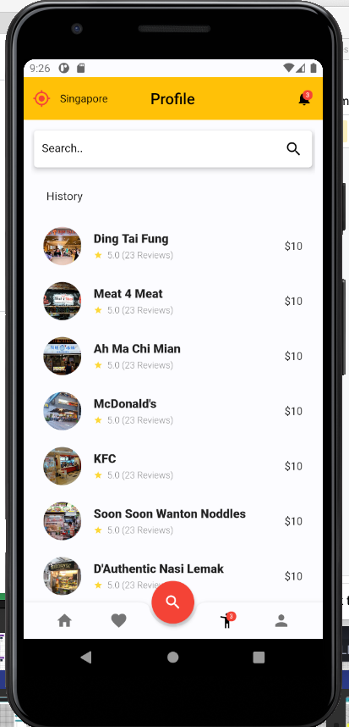
Final App - Simple, Functional, Aesthetic

Slide 25
Project Management

Slide 26



Project Management
Project Organisation
Roles & Responsibilities
Project Schedules
Activity Dependencies and Schedule
Work Breakdown Structure
Project Estimates
Code Size Estimation
Efforts, Duration & Team Size Estimation

Slide 27

Project Organisation
The following is the list of executive roles, as required by CMM level 3:
Senior Management:
Jethro Phuah
Software Engineering Project Group:
Lam Zhi Fah,
Ernest Ang Cheng Han,
Ong Jing Heng Shaun,
Shannon Tan Xinyi
Software Quality Assurance Engineer:
Ong Sim Hao
Scrum-in-charge :
Alicia Chua Jieying

Slide 28
Roles & Responsibilities
Project Manager:
Jethro Phuah
Oversees project progress
Approves and executes project plan
Assigns tasks and reports status of project to team members
SCRUM Master:
Alicia Chua Jieying
Formulates goals
Analyses and documents core processes and systems
UI/UX Designer:
Shannon Tan Xinyi
Designs User Interface & User Experience
Creates user manual
Front-end Developer:
Lam Zhi Fah
Ensures usability of the system is in accordance with the planned design
Ensures stability and response time of the system meet the requirements
Back-end Developer:
Ernest Ang Cheng Han, Ong Jing Heng Shaun
Implements product based on detailed design document
Ensures functionality of the system
Quality Assurance Engineer:
Ong Sim Hao
Ensures product meet client’s requirement
Designs testing strategies
Performs usability testing to detect error and bugs

Slide 29
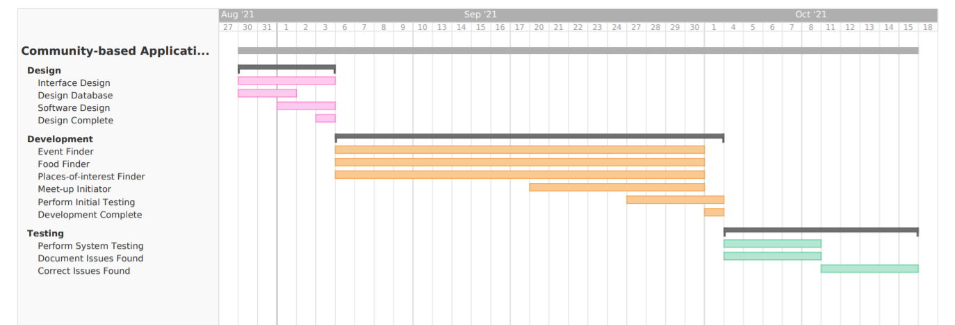
Project Schedules
Activity Dependencies and Schedule

Slide 30
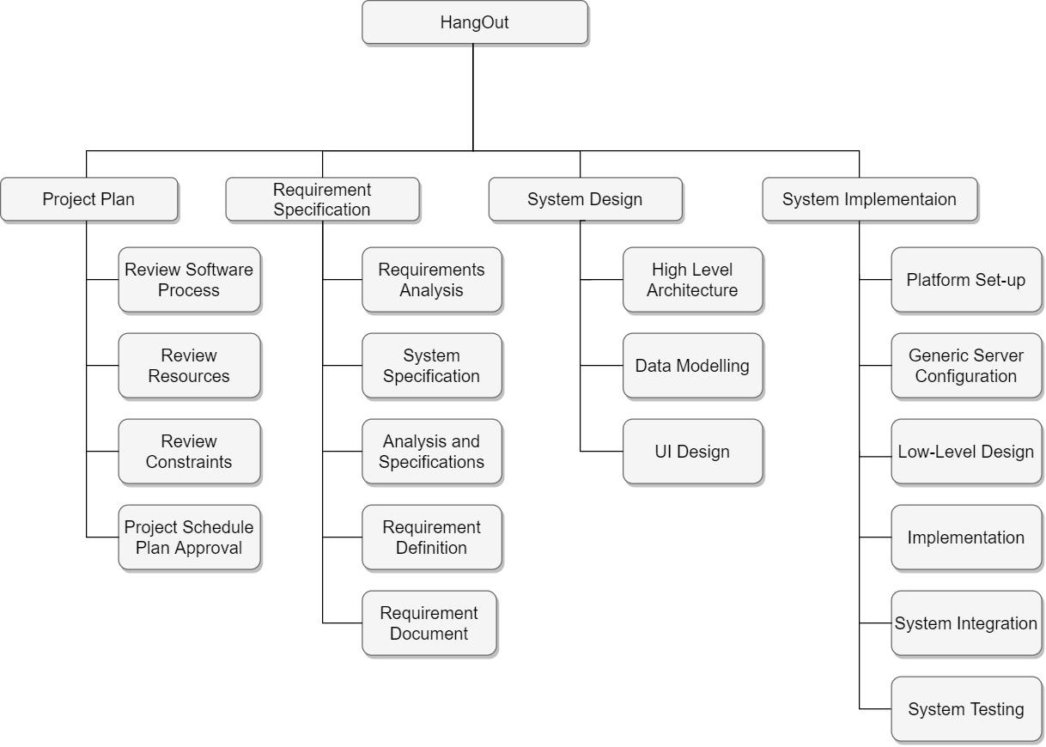
Project Schedules
Work Breakdown Structure

Slide 31
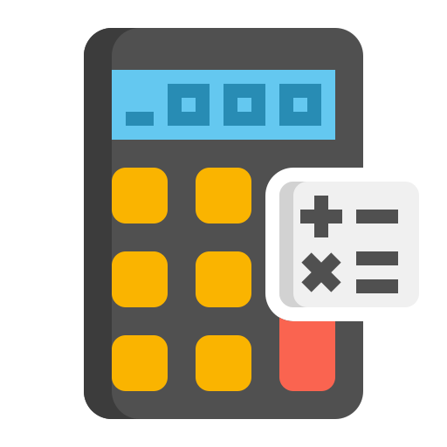
Project Estimates
Code Size Estimation using Function Points
We calculated unadjusted function points based on the complexity of functions provided by the Hangout App. Code size is then estimated by adjusted function point.
Total Unadjusted FP = 95
Total Adjusted FP = 95 * 1.00 = 95
Lines of Code = 95 FP * 29 LOC/FP = 2755 LOC
*More details can be obtained from Hangout Project Plan document

Slide 32
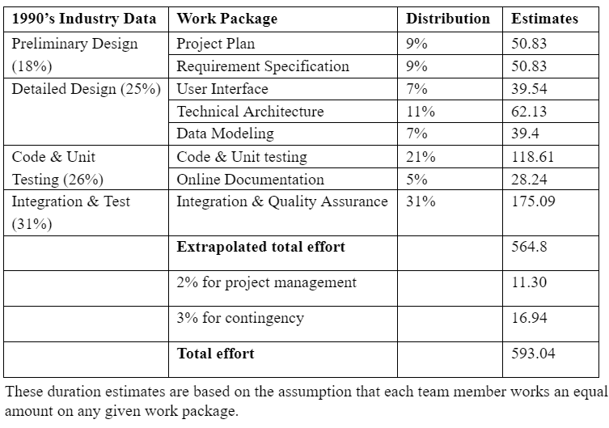
Project Estimates
Efforts, Duration & Team Size Estimation
*More details can be obtained from Hangout Project Plan Document.

Slide 33
Risk Management

Slide 34

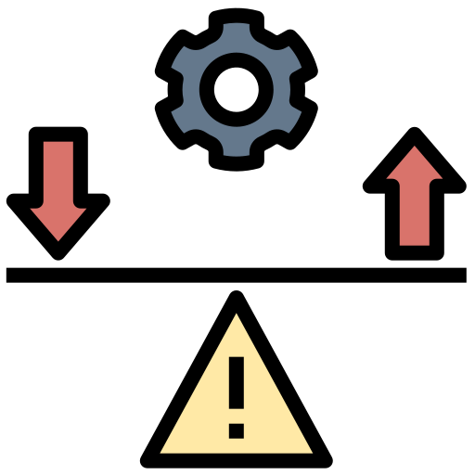
Risk Management
Risk Assessment
Risk Control

Slide 35


Risk Assessment
Risk Identification
Risk Analysis

Slide 36

Risk Identification
Our team has decided to make use of the Delphi Technique to identify potential risks.
The Delphi Technique involves collecting views and opinions from a group of experts through several rounds of questioning and discussion. After each round, a summary report of all experts’ views will be provided. The experts will review the report for that round and each of them will share on whether he/she is agreeable to everything written.
The process repeats until a common consensus is reached and there are no more disagreements. Given that our team consists of professionals who have been in the industry for a long period of time, this method will be robust in ensuring we cover all potential risks, and ensures that everyone is on the same page.

Slide 37

Risk Analysis
All identified risks will be assessed to determine the range of possible project outcomes. Risks will be prioritised according to professional opinions and data gathered from past projects.
High priority risks will be prioritised. The team will have mitigation and contingency plans put in place to ensure that such risks are minimized and even if they do occur, their impact will be minimal to the project.
Low priority risks will be monitored as well, albeit to a smaller extent.

Slide 38
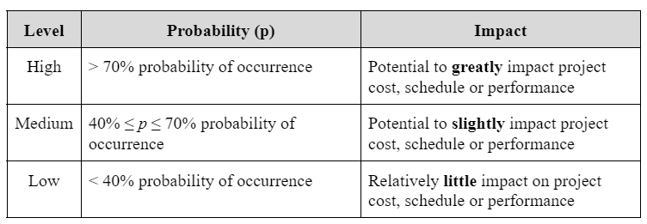
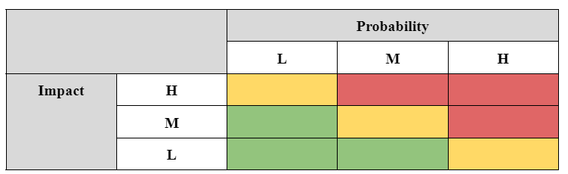
Risk Analysis

Slide 39
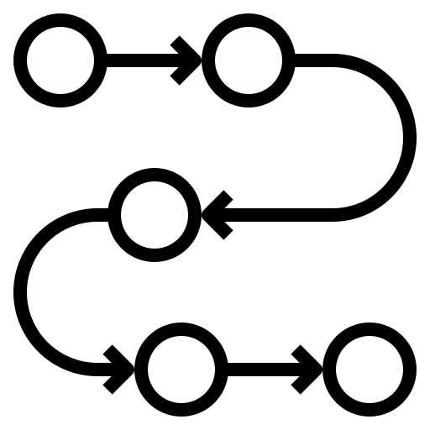

Risk Control
Risk Management Planning
Risk Monitoring

Slide 40
Risk Management Planning
Each major risk (those in the red and yellow zones in section) will be assigned to a project team member for monitoring purposes. This is to ensure that no risk will go unnoticed and the team is able to apply the proper mitigation steps (if necessary) to avoid it from being realised.
For each major risk, the team will select one of the following approaches to address it:
Avoid - Eliminate the threat totally by eliminating the cause
Mitigate - Identify ways to reduce the probability or impact of the risk
Accept - Nothing will be done to the risk
Transfer - Outsource this risk to a third party. This third party will be responsible for this risk

Slide 41
Risk Management Planning
For each risk that will be mitigated or accepted, the project team will come up with ways and methods to prevent the risk from realising.
If that is not possible, the team will have proper plans and steps in place to reduce its impact and probability of occurring.
Plans may include, but not limited to prototyping, adding tasks to the project schedule and adding resources.

Slide 42
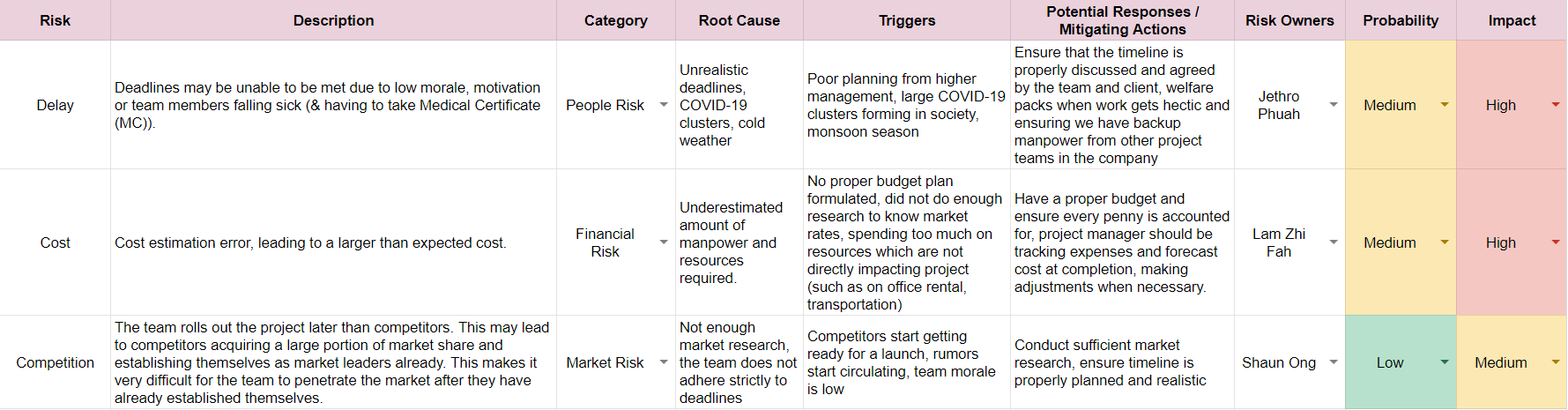
Risk Management Planning

Slide 43
Risk Monitoring
The project’s risks will be tracked, monitored and reported throughout the project lifecycle.
The project team will maintain a list of all risks in the risk register. The top 10 risks in the risk register will be given more focus, maintained and reported as a component of the project status reporting process for this project.
All change requests will be analysed first for their possible impact to the project risks. Next, management will be notified of important and significant changes to the risk status.

Slide 44
Demonstration

Slide 45
Thank You!

Slide 46
Lab 1
Brainstorming of ideas for application
Delegation of roles in the team by analysing strengths and weaknesses of members
Project proposal planning and setting of deadlines
Lab 2
Discussion on features and use cases of application
Assignment of documents to respective members to complete
Quality Assurance [3 members]
SRS [4 members]
Connection to database
Develope Lo-Fi prototype

Slide 47
Lab 3
Review of Lo-Fi prototype
Assignment of documents to respective members to complete
Quality Assurance [3 members]
SRS [4 members]
Delegation of roles for application development
Lab 4
Review of initial prototype of application
Assignment of documents to respective members to complete
Design report [2 members]
Software Configuration Management Plan [2 members]
Release Plan [1 member]
Change Management Plan [2 members]
Finalise completion of application and conducting test runs

